Slide 1
Compiere
Open Source ERP & CRM
Jorg Janke
Principal ComPiere, Inc.
Monroe, CT - USA

Slide 2
Introduction
Compiere is the premier Open Source Business Application
  660,000+ Downloads
  Usually Top 10 SourceForge Projects
    Since March 2002
  Forum 10,000+ postings – 45 developers
  50,000+ unique visitors/month www.compiere.org
  Systems in Production: ?? At least 50 worldwide
Designed from Scratch
  Started Jan 1999 – First Production: Mar ’01
  Experience with Oracle Applications, SAP, M&D, …

Slide 3
Agenda
Open Source
  How does Compiere fit in?
Compiere Business Model
  Partner Model
Architecture & Motivation
Target Market, Functionality
& Differentiation

Slide 4
Open Source .. Used for
Products w/o Intentions “Gadgets”
  “See what I did”
Discontinued Products
  Unsuccessful Products, Vendors Bankrupt
Marketing
  Platform Promotion
  Teaser/Entry Product, Sales Lead
Professional Open Source
  Base for Service Companies
Compiere

Slide 5
Open Source .. Benefits
Vendor Independence
  Let the Source be with you!
Stable, well tested
  Relatively easy to use
No information hiding
  ALL information available
Extraordinary wide reach
  No starting costs – Global Info exchange

Slide 6

Open Source .. License
Read the License .. More important and with far more consequences than commercial “If you open .. you agree”
Compiere License
  No Mandatory feedback
  Commercial Re-Distribution

Slide 7

Open is not “Everything Free”
Open Source
  = No License Costs (Shareware)
  + Source Code
  + Derived Work Distribution
Four Ways to Win
  Support Sellers (RedHat, JBoss, ComPiere, …)
  Loss Leaders (Netscape, …)
  Widget Frosting (SG – Samba, …)
  Accessorizing (Books, Pre-Installed, T-shirts, …)

Slide 8
Open Source Environment
Infrastructure
  Easy Distribution
  Collaborative Dev Environment
  High visibility
    Techies
Management
  Project Control
  Advisory Board
License
Community
  No Info Hiding
    Everything Open
    Info Overflow
    Fanatics
  Direct Feedback
    No Protection
  Want to contribute
    No Commitment
  Testing
Unreliable

Slide 9
Compiere Development
#1
Open Source
Business Apps
Priority determined by
  Partners – Customers – Sponsors
Contributions
  Design more important than Coding
  Only coordinated Co-Development
    Cannot risk de-stabilizing core functionality
    Agreed Scope and Approach
  Please don’t try to dump your stuff!
    Do your Maintenance & Documentation

Slide 10

Compiere Communication
SourceForge Forums
  Chat only – Information Exchange
SourceForge Trackers
  Support Requests
    Fast feedback!
  Bugs
    When sure that it is a bug (with trace)
  Enhancement Requests

Slide 11
ComPiere Support
Eliminate
Open Source
Unreliability!
Ensure availability
and functioning of
your production system
Service Levels
  Self Service
  Advantage
DB License Options
  None
  Solution
  Extended Use
Downtime
Insurance
Top of
Priority List
Preventative
Maintenance

Slide 12
Product Dimensions
Lead in max
2 Dimensions
Price
  Cost of Ownership
Access
  Local Availability & Knowledge
Quality
  Meeting Requirements/Expectations
Service
  Help, Guidance

Slide 13
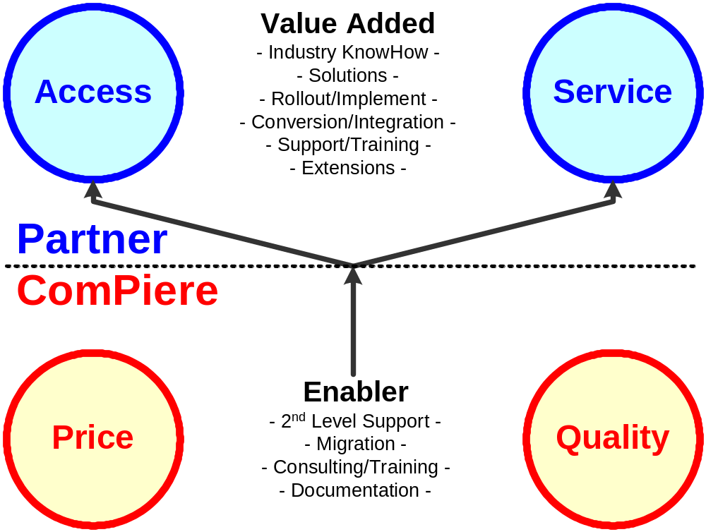

2 & 2 Partnership

Slide 14
ComPiere Partner
NO
Competition
Cooperation
  Advisory Board
  Priorities
Info Flow
  Monthly Conference Calls
Promotion
  Brand
  Partner
  Lead Generation
Certification
NO
Exit Strategy

Slide 15
Compiere Networks
User
Partner
Developer
Support

Slide 16
Compiere Foundations
Architecture & Motivation

Slide 17
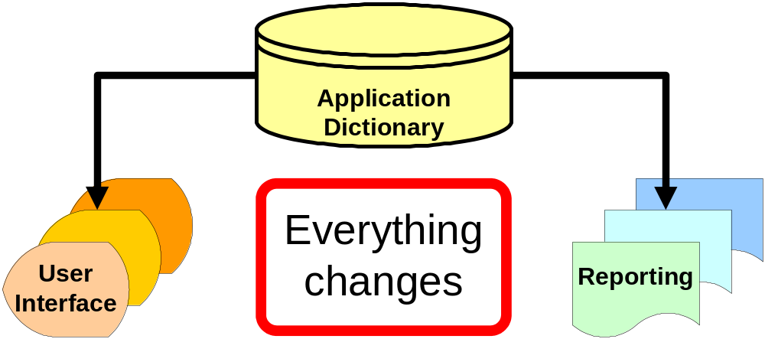
Compiere Drivers (1)
Model Driven Architecture

Slide 18
Model Driven Architecture
Superb Benefits – Application Dictionary
  Extreme fast development
  Extreme stable application
  Allows complete data driven navigation
Manageable “Costs”
  Meta Data = replacing code by data
    Developed Version Migration Toolset - from any Release
  Windows/Reports creation uses Client CPU
    Less Overhead than Oracle Applications & SAP

Slide 19
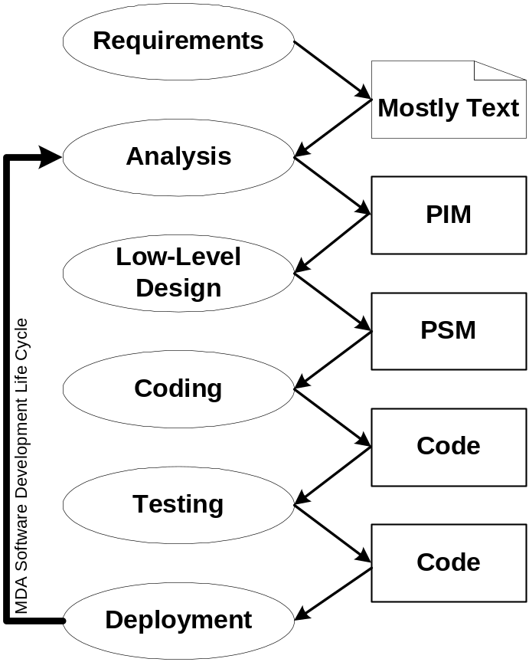

Model Driven Architecture
Object Management Group
  MDA
  Standard Body
  (UML, Corba, etc.)
Compiere is OMG
Domain Member
  Finance DTF
  Business Rules SIG

Slide 20
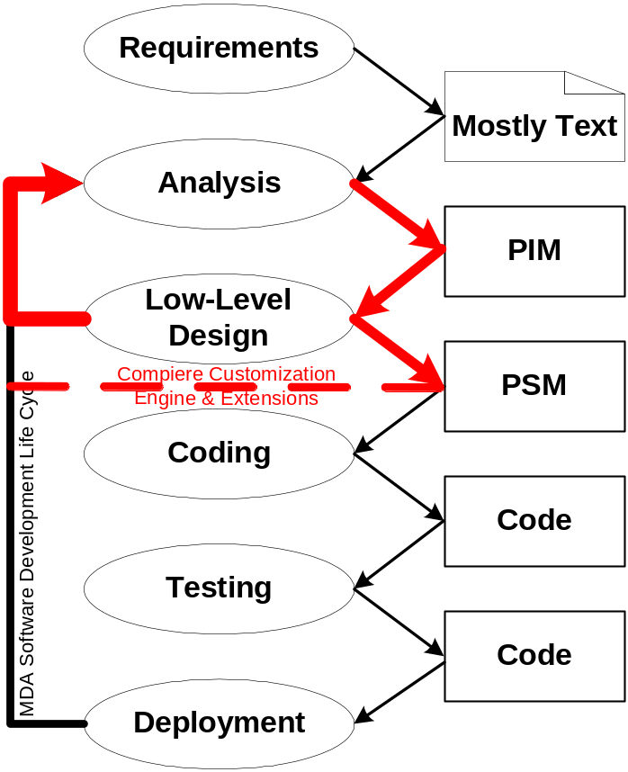
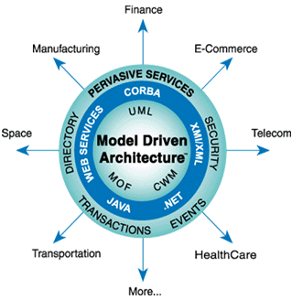
Beyond MDA
Compiere is a Platform Specific Model Engine for Business Applications
OMG’s AR/AP Facility Standard to be provided & implemented by Compiere
(Mid ’04) followed by GL

Slide 21
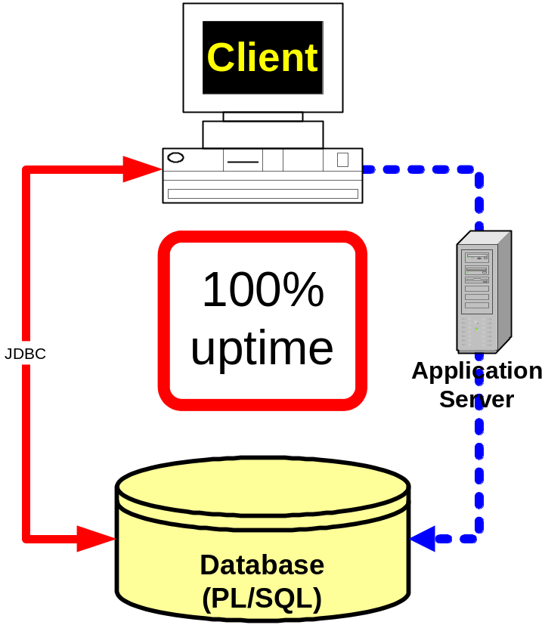
Compiere Drivers (2a)

Slide 22
Safe Fail
Too many sources for potential failure
  Hardware – Communication –
  Intended Use – Program Issues
Ability to tolerate partial system failure
  100% availability
Ability to detect issues
Ability to recover

Slide 23
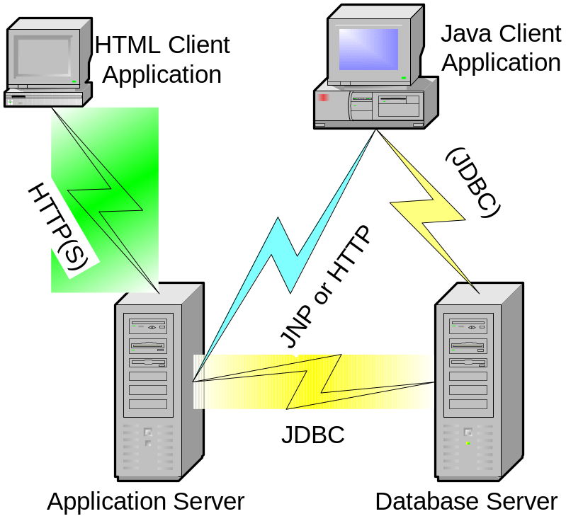
Multi-Tier
Database Server
  Oracle 9i2
  Any SQL DB (plan)
Application Server
  J2EE (JBoss based)
  Presentation for HTML Client
Java Client
  UI Generation
Windows
Linux/Unix

Slide 24
Connection Options
Compiere Client
  WebStart or Local Java Install
  LAN
  WAN or High Latency Networks
    Objects on Server (no JDBC connection)
    Tunnel through HTTP
Compiere Server
  (Remote POS – Replication/Synchronization)

Slide 25
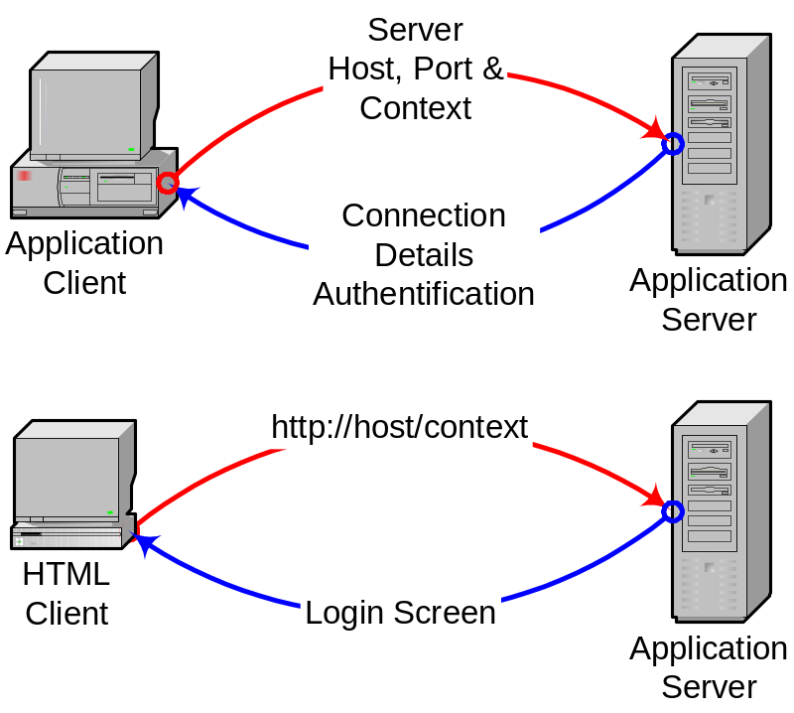
Multi-Tenant (ASP)
Client connects to
  Host
  Port
  Context
Application Client
  jnp://host:port
    Context as Parameter
  http://host/context

Slide 26
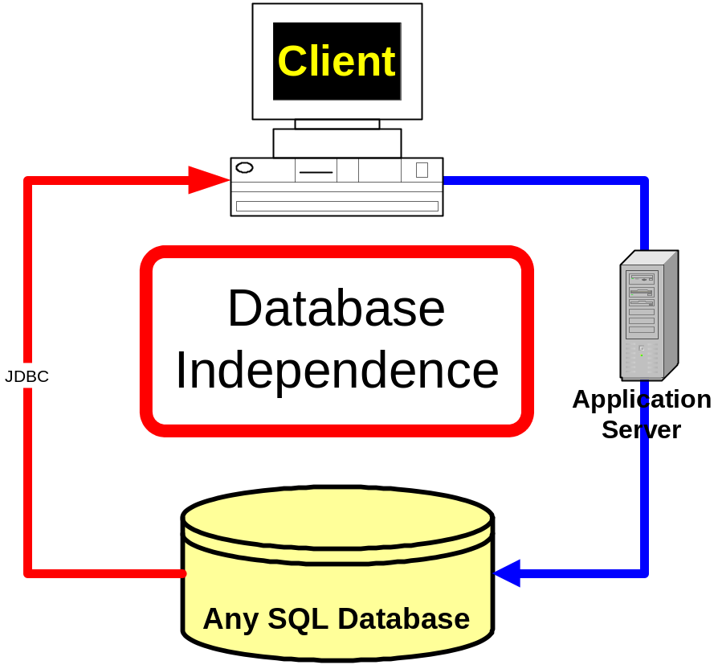
Compiere Drivers (2b)
100%
uptime

Slide 27
Compiere Position
Target Market
Functionality
Differentiation

Slide 28
Target Market
Distribution - Retail
Service
(Project Manufacturer)
Small-Medium Enterprises
  Individual Companies
  Distribution Chains & Outlets
    Manufacturer
    Franchise

Slide 29
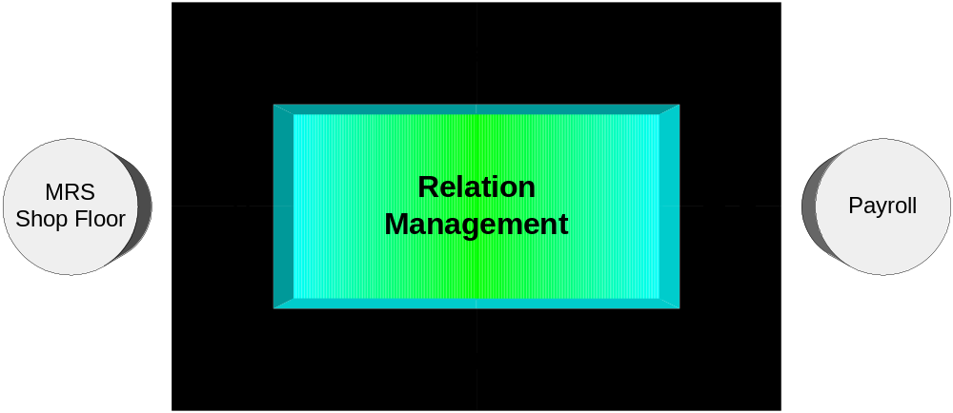
Functionality
Integrated
Business
Processes

Slide 30
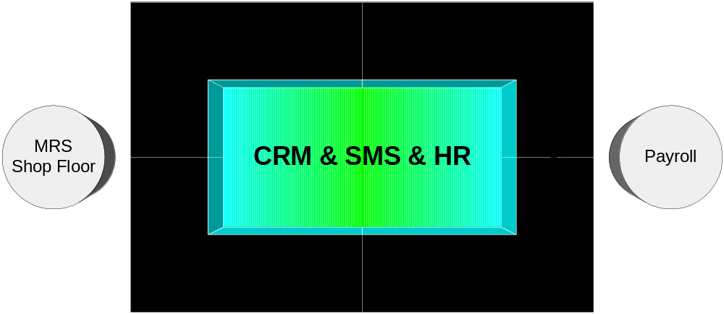
Functionality “Mapping”
Departmental
Boundaries

Slide 31
Integration
Integrated Application – No Patchwork
  Designed to work together
    Consistent - Learn quickly
  Functionality
    Business Processes
  Technology
    Report Writer
  Only external Interface work required

Slide 32
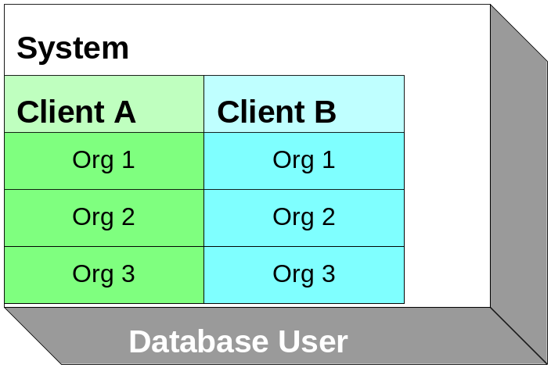
Multi-Org
One Database User
  = System
  Multiple Clients
    Multiple Organizations
Data Sharing
  System
  Application Dictionary
    General Setup
  Client
    Setup & Data
    Accounting Schema
  Organization
    Transaction
Extensive
(Row/Column)
Security Rules

Slide 33
Multi-Accounting
Multiple Accounting of Documents
  Management & Legal Reporting
  Local & Corporate
Accounting Schema
  Currency
  Chart-of-Accounts
  Costing-Method
Document
Accounting
Consequence

Slide 34
Multi-Lingual
User Environment
  Translated Screens, Reports
  Date/Number Format
Documents
  Product Descriptions, Payment Terms, …
  Invoices, Order Acknowledgements, …

Slide 35
Information Structure
Change ANY time
  Chart of Accounts
  Account Segments/Elements
    Business Partner, Product, Project,
    Sales Region, Marketing Campaign,
    Activity, … User defined
  (Multiple) Hierarchies of Account Elements
Re-Post if required

Slide 36
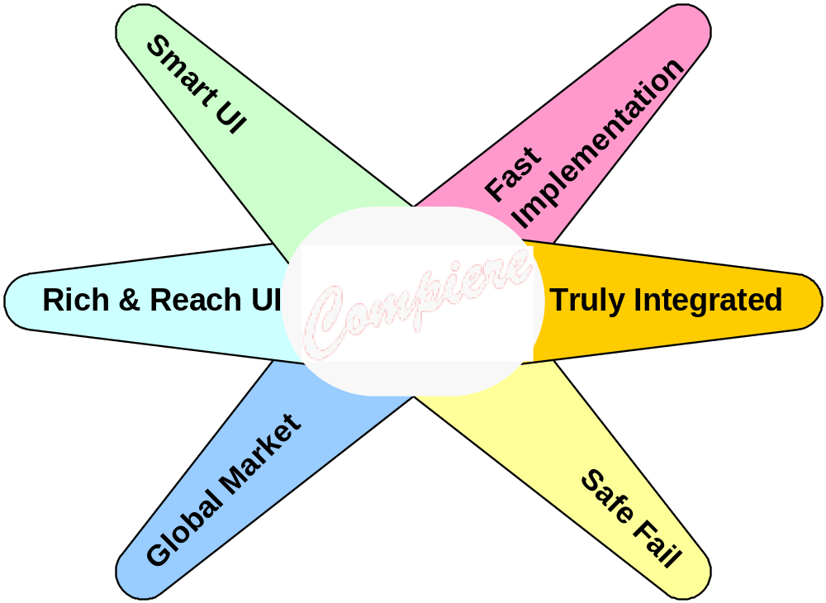
Compiere Differentiation
CPU
CRM
OLAP
Network

Slide 37
See for yourself
Test on your PC
  DB, Server and Client on one box
  512 MB RAM (more does not hurt)
  5 GB Disk space
Installation will take 1-4 hours
  Dependent on technical experience
  Faster on Windows than on Linux
Learn with “GardenWorld”
  Create own Client after you are familiar
  with Compiere

Slide 38
Next Steps
Try for yourself
  You’ll get more than you have paid for ☺
Use it efficiently
  Sign up for 5 day Intensive Training
    http://www.compiere.com/training
Protect your Investment
  Get a Support Contract
    Downtime Insurance
    Top of Priority List
    Preventative Maintenance
Build your own Business - Sign up as Partner

Slide 39
Compiere – The safe Choice !
Compiere will not disappear/be discontinued
  The user base is far to big
You are not dependent on any Vendor
  Everything is available to you
You can rely on dependent Help
  It’s your decision – In-House vs. External
  Pay for Professional Services not empty License
  Many alternatives – worldwide!
    Check out http://www.compiere.org/support

Slide 40
ComPiere, Inc.
Initial contributor of Compiere
  Located in Connecticut, USA
Our “Sales Force”
  The Compiere Product and Compiere Partners
Development Effort sponsored by
  Support
  Training
  .. but also directly
Cash Flow positive ☺
See you
24-28 May
Bonn, Germany

